Slide 1

Sports Analytics III
Produced by Dr. Mario
UNC STOR 538

Slide 2
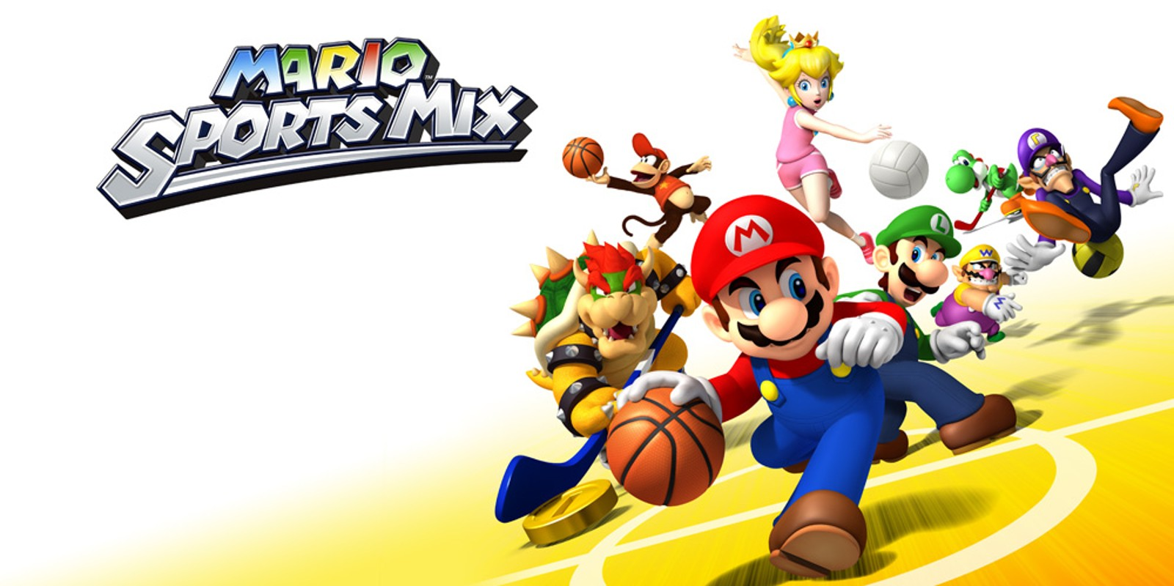
Industry Past
Sports Analytics Use Survey (2013)
Sample of 27 People (NFL, MLB, NBA, EPL)
How Many Different Sources?
1-2 (6.7%)
3-4 (33.3%)
5-6 (13.3%)
>6 (46.71%)

Slide 3
Industry Past
How Much Data is Centralized?
All (31.3%)
Most (37.4%)
Some (31.3%)
How Much Data is Dependent on One Person?
Some (50.0%)
Most (43.7%)
All Data Centralized (6.3%)

Slide 4
Industry Past
Is Data Checked for Errors?
Always (31.3%)
Usually (37.5%)
Sometimes (18.8%)
Occasionally (6.1%)
Rarely (6.3%)
How Many Database Programmers are Employed?
0 (37.5%)
1-2 (50.0%)
3-4 (0.0%)
>5 (12.5%)

Slide 5
Industry Past
How Many Statistical Analysts are Employed?
0 (20.0%)
1-2 (66.6%)
3-4 (0.0%)
>5 (13.3%)
Roadblock: Difficulty Identifying Strong Applicant
Difficulty in Both Hiring and Evaluating

Slide 6
Industry Past
Clear Process for Hiring/Evaluating Analysts
Strongly Agree (13.3%/14.3%)
Somewhat Agree (13.3%/14.3%)
Neutral (26.7%/28.6%)
Somewhat Disagree (13.4%/21.4%)
Strongly Disagree (33.3%/21.4%)
Analytic Resources in Line with Strategic Game Plan
Strongly Agree (26.7%)
Somewhat Agree (33.3%)
Neutral (33.3%)
Strongly Disagree (6.7%)

Slide 7
Industry Present
Value Placed on Sports Analytics
Business Research Company Analysis
Global Sports Industry $486.61B to $512.14B
Actual CAGR of 5.2% in 2023
Expected to Grow to $623.63B in 2027 (CAGR 5%)
Deloitte Article Industry Trends for 2023

Slide 8
Industry Present
Value Placed on Sports Analytics
Grand View Research on Sports Analytics Market
Valued at $2.73B in 2022 and $3.52B in 2023
Expected CAGR Between 2023 and 2030 is 22.3%
Software Segment Dominates at 61% of Market
Services Segment Expected to Grow by 19%
On-Field Analytics (61%) Dominates Off-Field Analytics
$Projection in 2030=3.52∗(1+CAGR)^7$ =14.41
$14.41B
$2.73B
$3.52B
2022
2023
2030

Slide 9
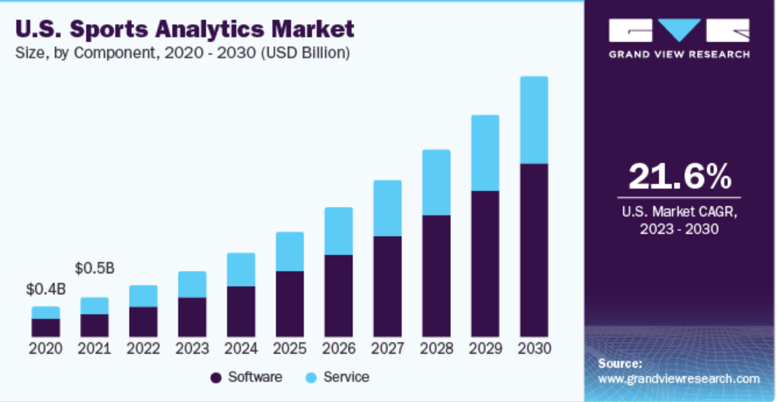
Industry Present
Value Placed on Sports Analytics
Grand View Research on Sports Analytics Market

Slide 10
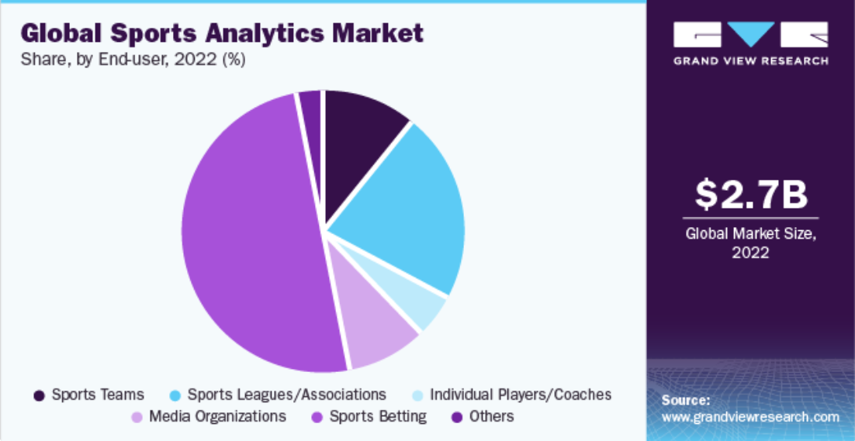
Industry Present
Value Placed on Sports Analytics
Grand View Research on Sports Analytics Market

Slide 11
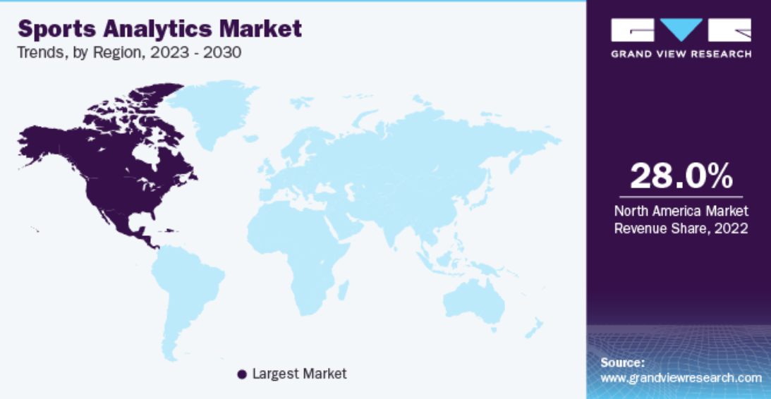
Industry Present
Value Placed on Sports Analytics
Grand View Research on Sports Analytics Market

Slide 12
Industry Present
Value Placed on Sports Analytics
Grand View Research on Sports Analytics Market
Agile Sports Analytics, LLC
Catapult Sports
ChrynoHego Corporation
Deltatre
Experfy Inc.
Genius Sports Group
IBM Corporation
Oracle Corporation
SAP SE
SAS Institute Inc.
Sportradar AG
Stats Perform

Slide 13
Industry Present
Modern Applications of Sports Analytics
Helping the Team Win
Automated Video Analysis (Lincoln City, UK Football)
3D Depth Camera (NBA)
Wearable Technology (NBA, NHL)
Improving the Fan Experience
Analysis of Digital Engagement
Sentiment in Social Media
Analysis of Fan Behavior in Stadium (New England Patriots)
Wireless Internet and Phone Apps
Apps Supply Game Analytics, Parking Information, Promotions, and Traffic Information to the Fans (NFL)

Slide 14
Industry Present
Modern Applications of Sports Analytics
Benefiting Other Stakeholders
Tracking Fan Behavior Outside the Stadium
Telecommunication, Retailers, Payment Providers, Ticket Agencies, and Sponsorships
Adapt to Quick Changes in Consumer Behavior
Optimizing the Back-Office
HR Practices
Game Scheduling
Supply Chain Management and Logistics
Marketing and Promotions
Procurement of Goods and Services

Slide 15
Industry Present
Modern Applications of Sports Analytics
Advancing Sports Gambling
Supreme Court Ruling Previous Statute Violated 10th Amendment (Murphy v. National Collegiate Athletic Association)
States Free to Legislate Gambling
Improvement of Gambling Products
Data Aggregation and Visualization for Bettors
Develop Daily Fantasy Sports
Grandview Research
Global Market Valued at $83.65B in 2022
Projected to Reach $182.12B in 2030

Slide 16
Your Industry Future
Prerequisites by Howard Hamilton
(Soccermetrics)
Technical Skills
Mathematics (Linear Algebra/Probability Essential)
Statistics (Frequentist and Bayesian Perspectives)
Machine Learning (Supervised and Unsupervised)
Programming (R/Python, Data Structures, OOP)
Databases
Visualization
Socials Skills, Ethics, and the Law
Knowledgeable About All Aspects of the Sport

Slide 17
Your Industry Future
Real Jobs (Indeed)
Data Scientist, FanDuel
Bachelor’s Degree in Numerate Degree
Build Machine Learning Models
Data Collection and Cleaning
R or Python + SQL
Research Analyst, Harris Blitzer Sports & Entertainment
Gather, Validate, Synthesize 3rd Party Fan Data
Focus on Data Visualization and Communication Skills
EXCEL + PowerPoint + PowerBI

Slide 18
Your Industry Future
Real Jobs (Indeed)
Scheels All Sports, Inc
Retail Company
Machine Learning to Analyze Data
Data Collection and Improvement in Reporting Insights
Data Analyst, Elevate Sports Ventures
Consulting Firm for over 175 Sports Teams, Brands, Venues, etc.
Obtaining, Analyzing, Interpretating Market Sales Data
Lower Level and Data Entry Involved
Located in Charlotte

Slide 19
Your Industry Future
Real Jobs (Indeed)
Trading Analyst, DraftKings
Bachelor’s Degree in Math, Stats, CS, etc.
Experience with SQL, R, Excel or Python
Experience with Tableau
Data Analyst, Eventellect
Bachelor’s Degree in Math, Stats, CS, etc.
Research Regarding Single Game Ticket Sales
SQL Proficiency
Analysis of Large Datasets
Python Experience

Slide 20
Your Industry Future
Real Jobs (Indeed)
Marketing Analytics Analyst, NBA
Develop Dashboards Using Tableau or PowerBI
R or Python + SQL
Email Marketing Analyst, Arizona Cardinals
AB Testing on Email and SMS
Monthly Reports on Marketing Data
HTML + SQL + Python
Machine Learning

Slide 21
Your Industry Future
Real Jobs (Indeed)
Baseball Operations Analyst, Detroit Tigers
Master’s Degree Preferred. Statistics, Math, CS, etc.
Experience Working with Baseball Data
R or STATA or SPSS or SAS or Python
Expertise with SQL
Quantitative Sports Researcher, SIG
Master’s or PhD Preferred
Experience Working on Sports Analytics Projects
Build Statistical Forecasting Models Linked to Sports Betting

Slide 22
Your Industry Future
Conferences
MIT Sloan (March)
International Sports Analytics Conference (July)
UConn Sports Analytics Symposium (April)
OSU Sports Analytics Conference (April)
Carnegie Mellon Sports Analytics Conference (?)
New England Symposium on Stat. in Sports (2025)
Great Lakes Data and Analytics (April)
International Conference on Sports Analytics and Data Visualization (August)

Slide 23
Final Inspiration
Defense wins championships.
Offense wins contracts.
Be offensive.
- Mahatma Mario

